Slide 1

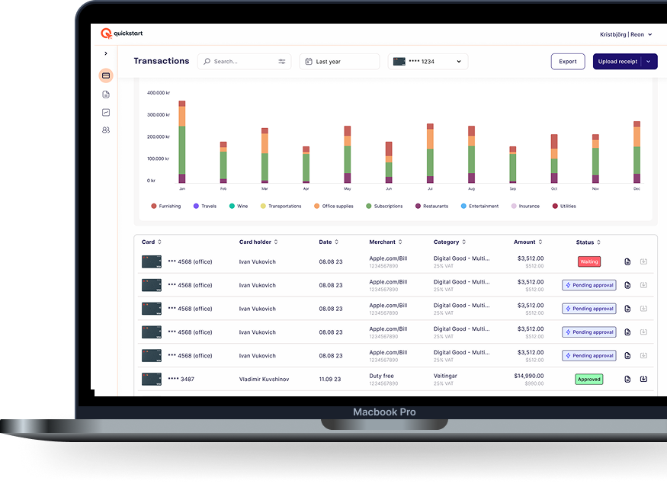
Better
Business.
90% of startups fail—not because of the idea, but because of operations

Slide 2


Most people start a business to solve a need.
Weather that need is a new protein bar or making an app for adopting pets they all need to do the same things; operate the company.
That means accounting, corporate governance, issue and sign contracts and manage cash flow. Not everyone is an expert on that.
The purpose of Quickstart is to become the infrastructure companies of the future are built on.

Slide 3
Running a business is harder and more time consuming than it should be.
For early stage startups and SMEs, startup inefficiencies cost both time and momentum and can cause major issues down the line.
Small business owners lose ~1.5 hours per day to unproductive tasks
Getting your business up and running with bank accounts, cap tables, expense management, contracts and company cards and everything else is a slow and complicated process.
Managing contracts, credit cards, receipts, legal and accounting all takes time away from real growth.
Future costs for early mistakes can be tremendous
Source: Entrepreneur.com

Slide 4
Being an amazing founder doesn't mean you are an amazing operator.
A typical founder path:
You have an idea for a business
You register your company
You get busy with building your business
Your business grows, time flies
You didn't organize everything well at the start because you were busy
You can't find contracts
You cant find receipts
You don't have good oversight
The problem keeps growing as the business grows and you stay busy
Quickstart can solve all that so you can focus on building your business.

Slide 5
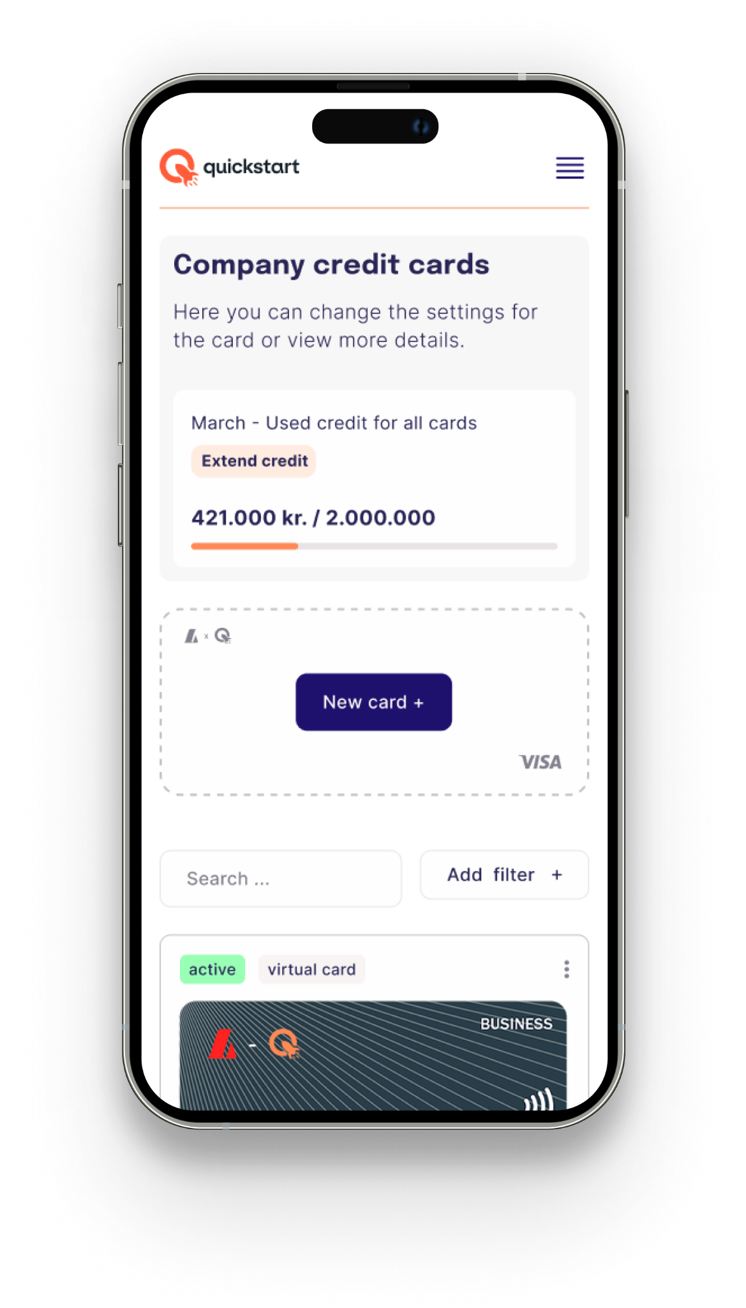
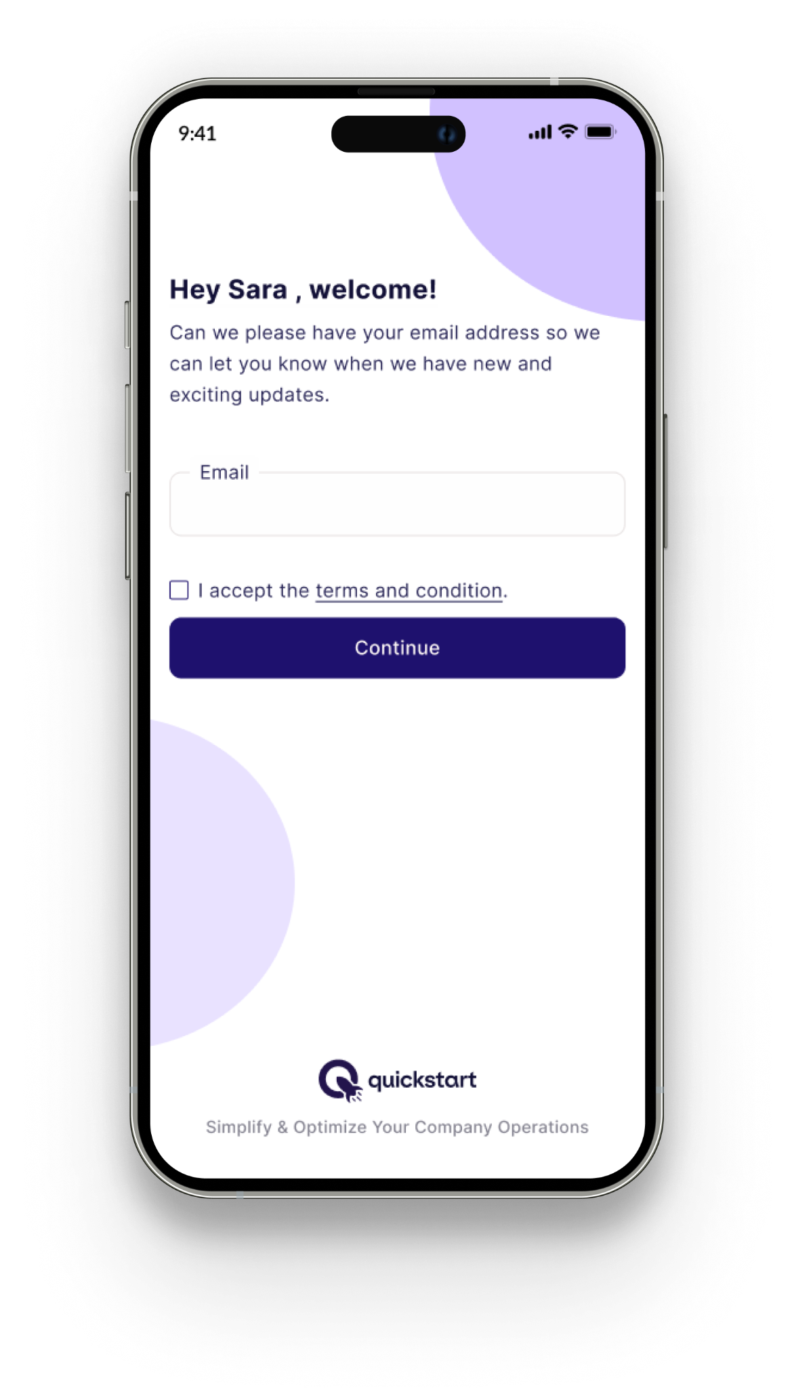
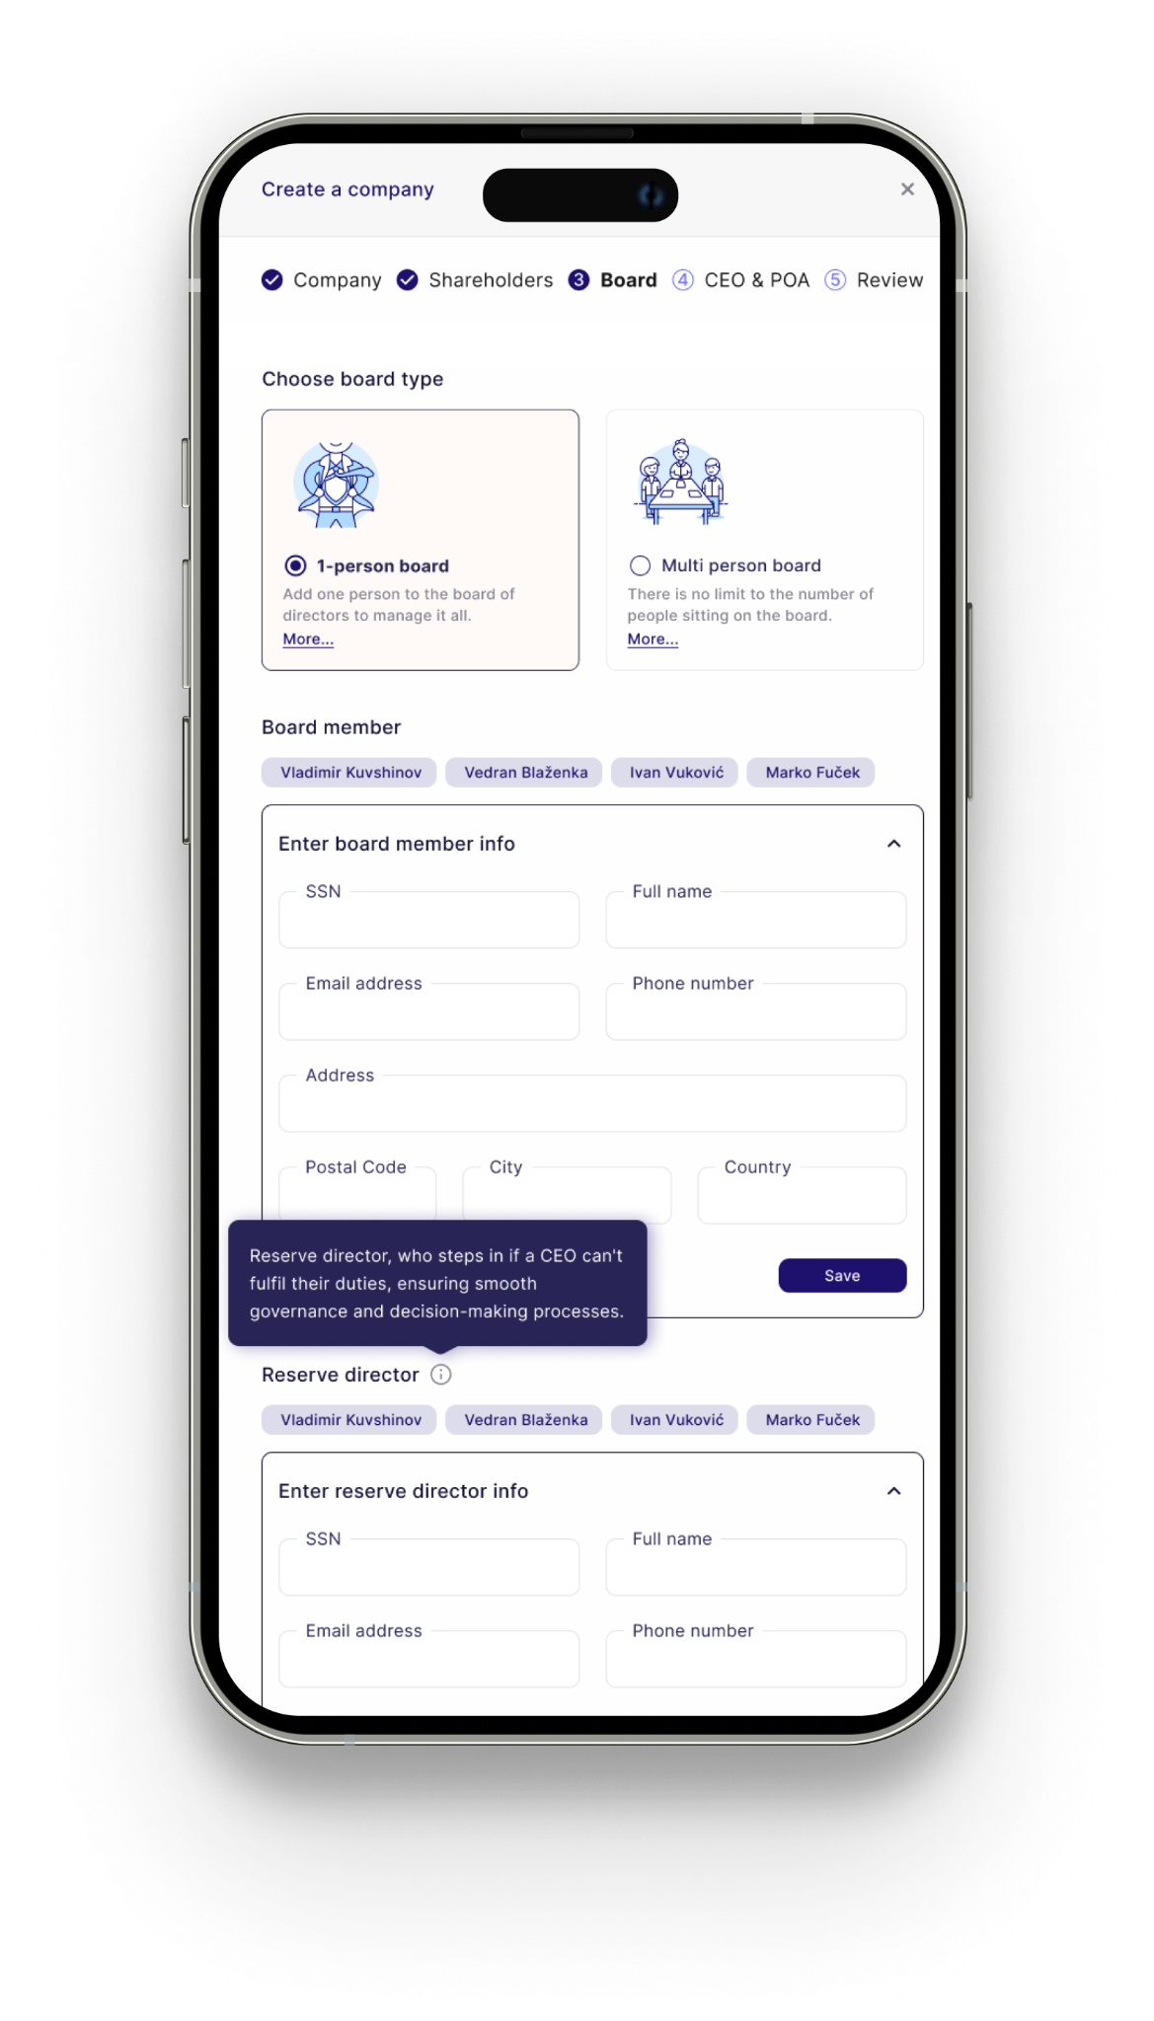
Solution
We built Quickstart to help founders build better businesses.

Slide 6
Solution
We provide a fast and complete way to start and run businesses!
At launch, we offer:
Company up and running in under 2 days - Digitized formation, with verified entity and registration.
Smart contract management - A built-in dashboard to store and manage all key documents, from contracts to articles of association, combined with e-signatures and smart, ready to sign contract templates.
Managed credit card suite - Issue virtual or physical cards, set spending limits, gather receipts, AI receipt management and automated syncing to your bookkeeping system.
Ready-to-Use Banking - A up and running corporate bank account and credit card with an initial limit - ready to use on day one.
Education - On the way we educate our user about every step of the formation process.

Slide 7



Solution
Our vision is to be the go-to operating system for your business.
Corporate Finance
Financial Overview
Starting a business
Telecommunications
Foreign Exchange/ Money Transfer
Legal
External services & providers
Core Value added services
Contract Management
Accounting
Credit Cards and Receipts
Insurance
Fundraising

Slide 8
Solution

Slide 9

Future
We want to be a swiss army knife for operations!

Slide 10
Future
Not just for startups. We want to grow with our clients from foundation and up.
As our customers grow we will be the engine organizing everything and helping them run a smooth operation.
Powerful expense management with built in AI.
Complete credit card management solution.
Cap-table, stock option and fundraising management.
AI powered contract management which keeps track of actionables and due-dates.
Data room that is always up do date.
Dashboard with an overview of your business and all subsidiaries.
Virtual mailbox management.
A network of partners that provide value adding services.
Overview of all invoices and bank accounts.
Ability to pay invoices through Quickstart.
Reimbursement management.
Business loans and fundraising tools.
Currency exchange 24/7 using a market rate.
And a lot more exciting features on our roadmap..

Slide 11
Future
Our future is business banking +
Quickstart is a operation dashboard for the company where you can manage all the finances of the company, pay bills, view bank statements, issue credit cards and manage their receipts, manage contracts, have an overview of all corporate files and more.
Quickstart aims at being the go-to business banking platform in Iceland and the Nordics, built on banking API’s.
Quickstart will be able to perform all the operations of a bank without being a bank.

Slide 12
Partnerships
Quickstart is seeking partners for external services and providers to create a holistic and valuable ecosystem for founders and businesses.
Telecommunications
Legal
Accounting
Insurance
And more…

Slide 13
Investment
Quickstart is seeking to raise €2M in this round of funding. This will allow us to execute on our next growth phase and position the company for scale.
The capital will be deployed across these three areas:
Sales & Marketing
Product development
Customer success and operations

Slide 14
Let’s work together!
Have a question?
vik@quickstart.is

